Slide 1
From CNN to YOLO
By: Bahaa El-din Helmy

Slide 2

Datasets

Slide 3
Pascal VOC
20 object categories as 4 main branches-vehicles, animals, household objects, and people
spread over 11,000 images.
Over 27,000 object instance bounding boxes are labeled
7,000 have detailed segmentations.

Slide 4
COCO DATASET
91 common object categories
82 of them having more than 5,000 labeled instances.
These categories cover the 20 categories in the PASCAL VOC dataset.
2,500,000 labeled instances in 328,000 images

Slide 5
OTHER DATASETS
Open Images
ImageNet

Slide 6
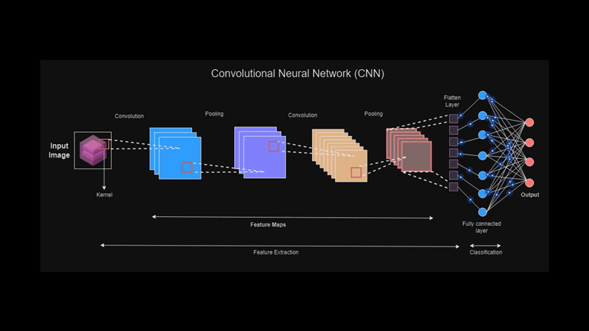
CNN

Slide 7
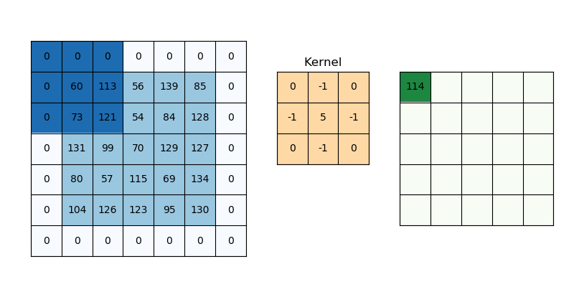

Slide 8
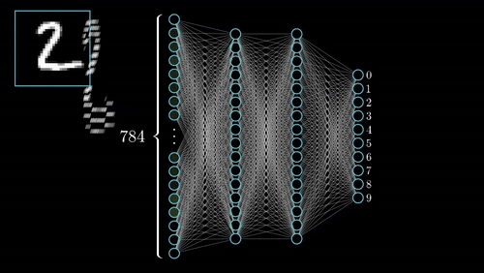
Image Classification Using CNN

Slide 9
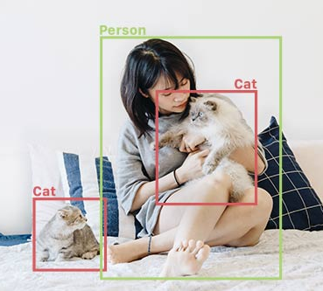
Object Detection
Identify and locate objects in an image or video
Source : https://www.fritz.ai/object-detection/#:~:text=Object%20detection%20is%20a%20computer,all%20while%20accurately%20labeling%20them.

Slide 10
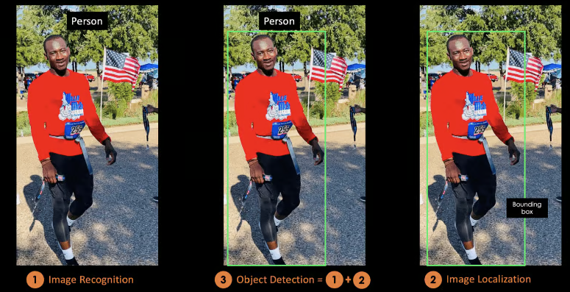

Slide 11
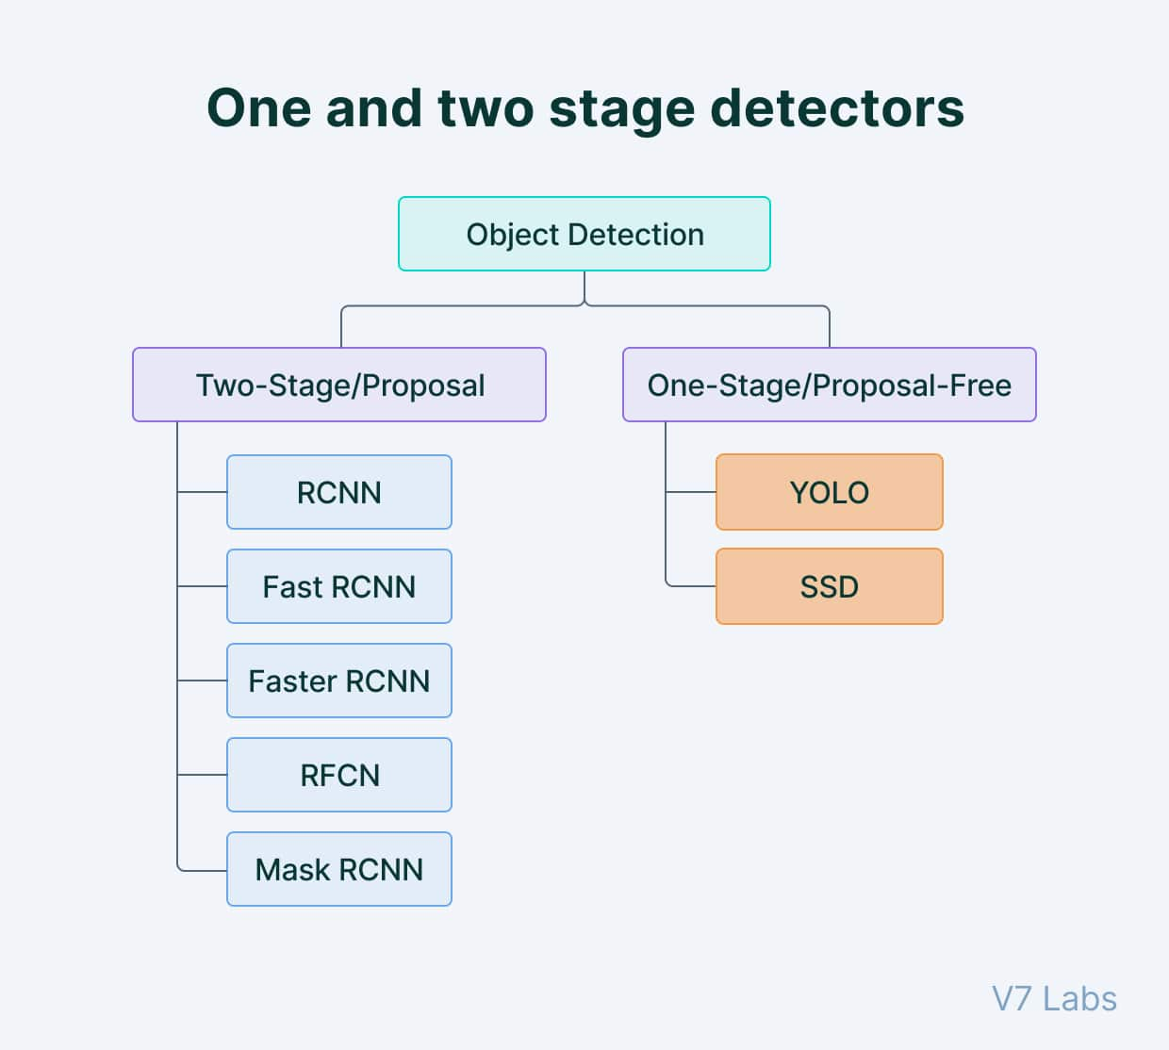
Kinds of Object Detection
Two-Stage Detector
One Stage Detector

Slide 12
Examples of Two Stage detectors
R-CNN
Fast R-CNN
Faster R-CNN
Masked R-CNN

Slide 13
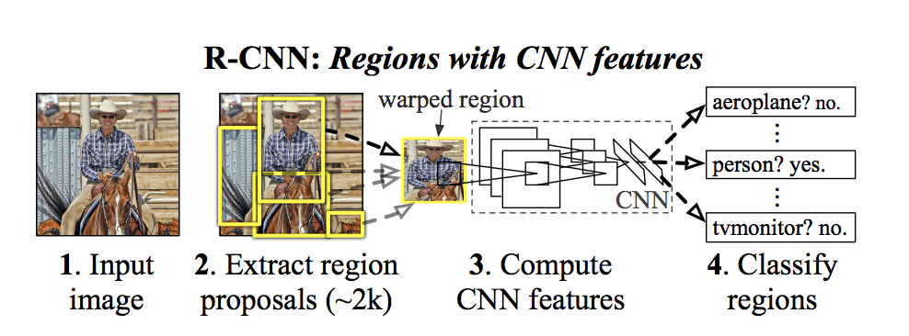
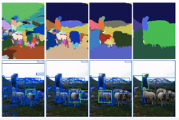
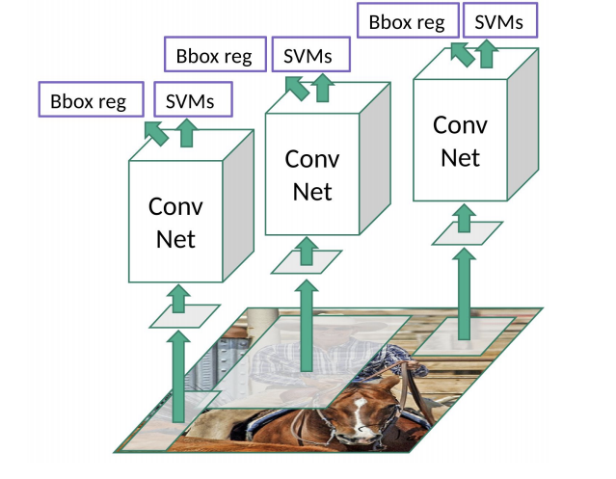
R-CNN
Generates category-independent region proposals through Selective Search (instead of trad window in CNN).
Extract a fixed-length feature vector from each region proposal.
Set of class-specific linear SVMs to classify the objects in one image.
Bounding-box regressor for precisely bounding-box prediction.

Slide 14
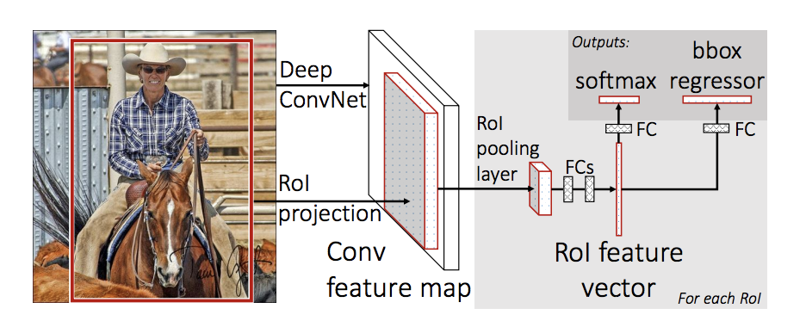
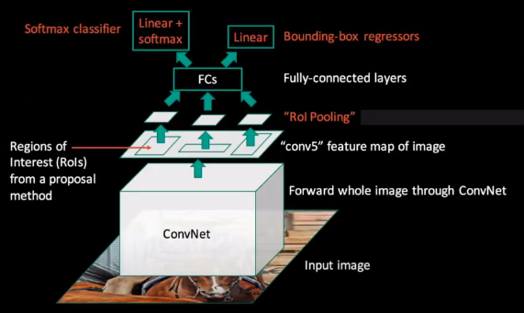
Fast R-CNN
Fast R-CNN produces Region of Interest(RoI) using the Max Pooling layer instead of Selective Search
the SVM layer is replaced with SVD which fastens the process even further.

Slide 15
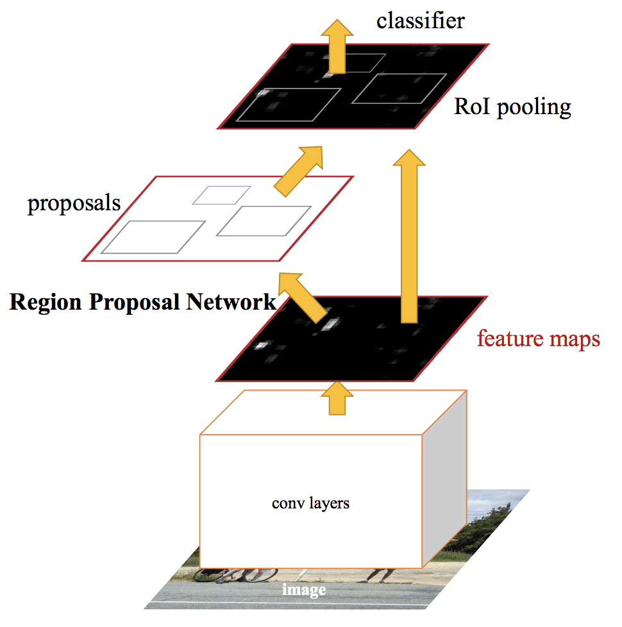
Faster R-CNN:
The Region interested in Fast R-CNN was based on a selective search using Max Pooling layers, this was slow.
So in Faster R-CNN replaces the region selection method with a novel RPN

Slide 16
Object detection
Localizing a region of interest within an image and classifying this region like a typical image classifier.
One image can include several regions of interest pointing to different objects.
While image classification classify the overall image (belongs to which class?)
This makes object detection a more advanced problem of image classification.

Slide 17
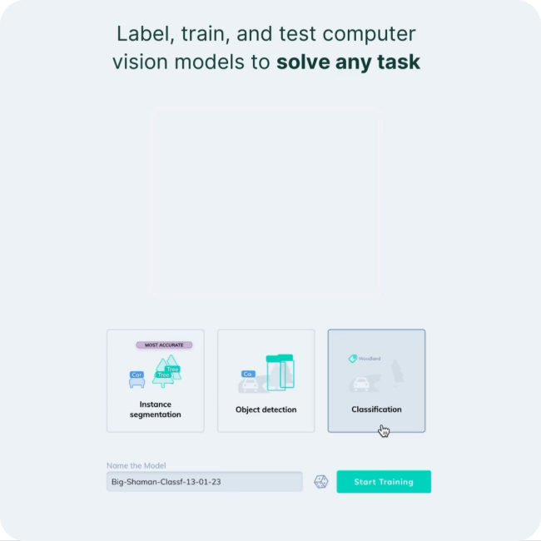

Slide 18
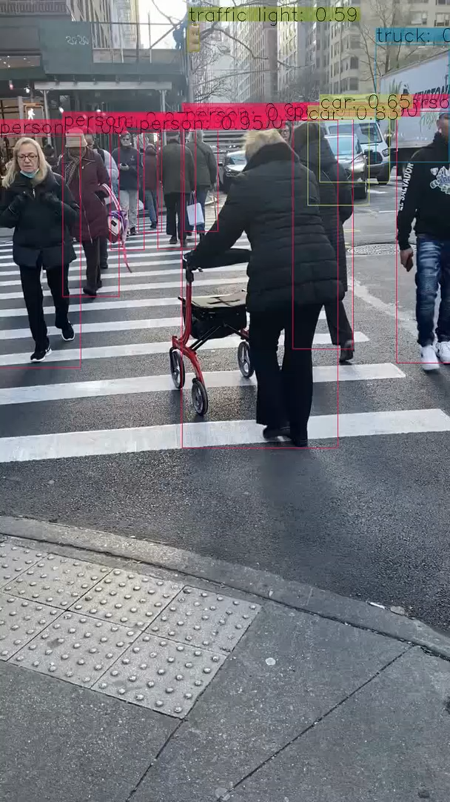
YOLO

Slide 19
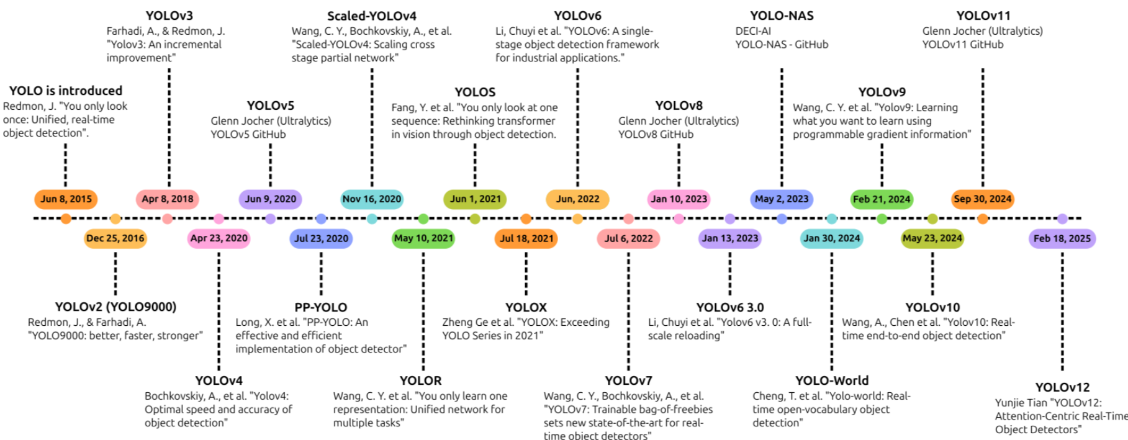

Slide 20
Object detection models performance evaluation metrics
Intersection over Union (IoU)
The intersection divided by the Union gives us the ratio of the overlap to the total area
Average Precision (AP)
Average Precision (AP) is calculated as the area under a precision vs. recall curve for a set of predictions.
Recall is calculated as the ratio of the total predictions made by the model under a class with a total of existing labels for the class. Precision refers to the ratio of true positives with respect to the total predictions made by the model.
The average of this value, taken over all classes, is called mean Average Precision (mAP).
Notes:
In object detection, precision and recall aren’t used for class predictions. Instead, they serve as predictions of boundary boxes for measuring the decision performance. An IoU value > 0.5. is taken as a positive prediction, while an IoU value < 0.5 is a negative prediction.

Slide 21
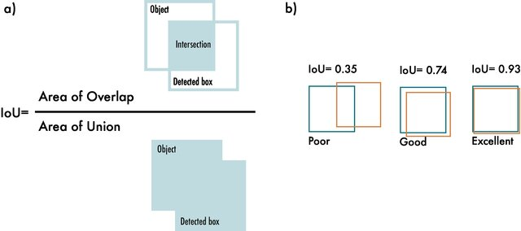
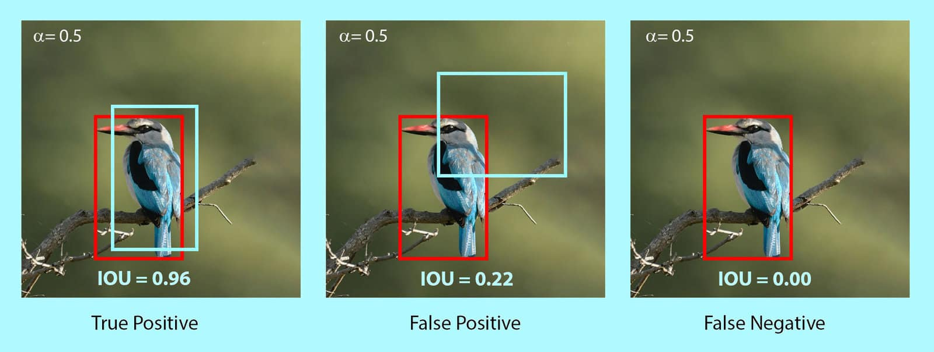

Slide 22
Why YOLO?
While algorithms like Faster RCNN work by detecting possible regions of interest using the Region Proposal Network and then performing recognition on those regions separately, YOLO performs all of its predictions with the help of a single fully connected layer.
Methods that use Region Proposal Networks perform multiple iterations for the same image, while YOLO gets away with a single iteration.

Slide 23
How the YOLO algorithm works
YOLO algorithm works using the following three techniques:
Residual blocks
Bounding box regression
Intersection Over Union (IOU)

Slide 24
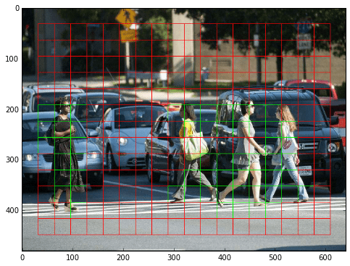
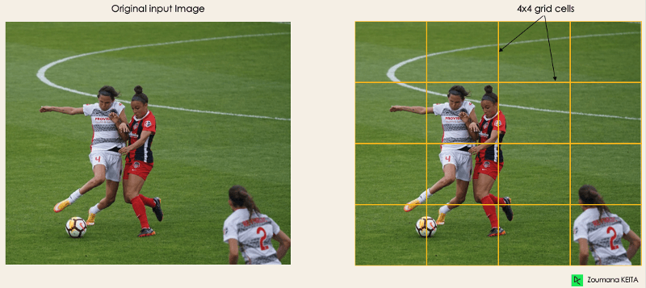
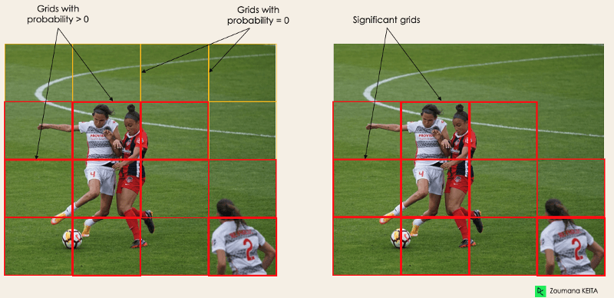
Residual blocks
Notes:
In the image above, there are many grid cells of equal dimension. Every grid cell will detect objects that appear within them. For example, if an object center appears within a certain grid cell, then this cell will be responsible for detecting it.

Slide 25
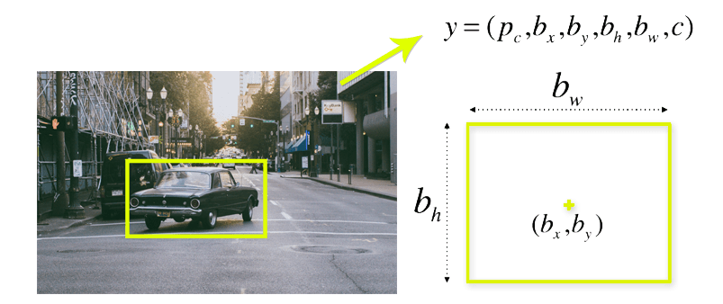
Bounding box regression
A bounding box is an outline that highlights an object in an image.
Every bounding box in the image consists of the following attributes:
Width (bw)
Height (bh)
Class (for example, person, car, traffic light, etc.)- This is represented by the letter c.
Bounding box center (bx,by)

Slide 26
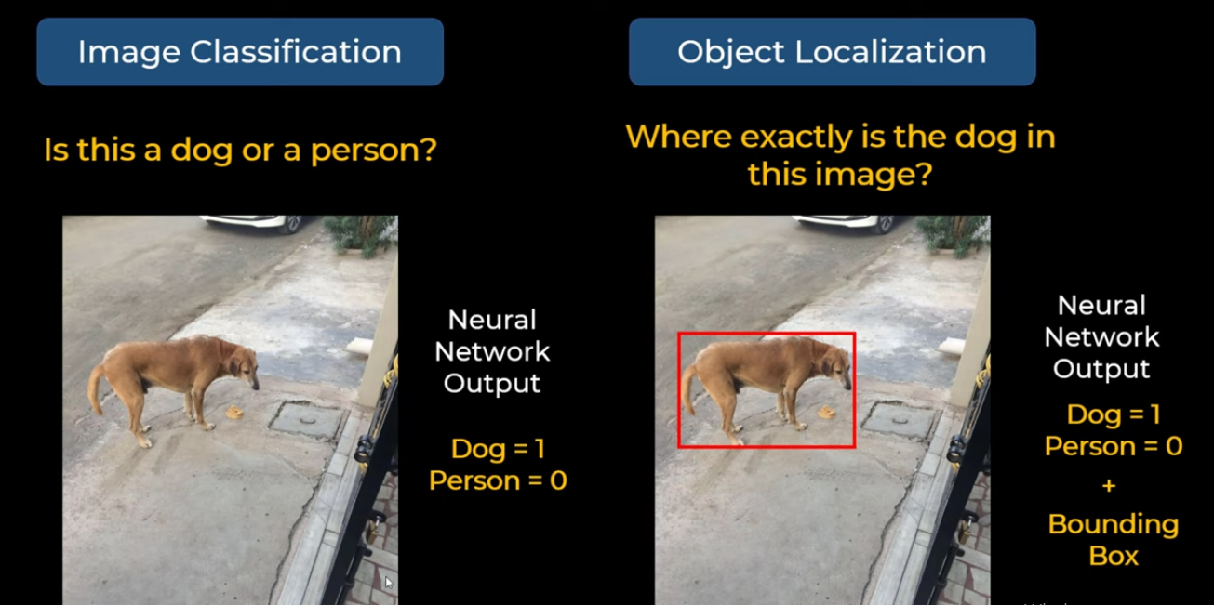

Slide 27
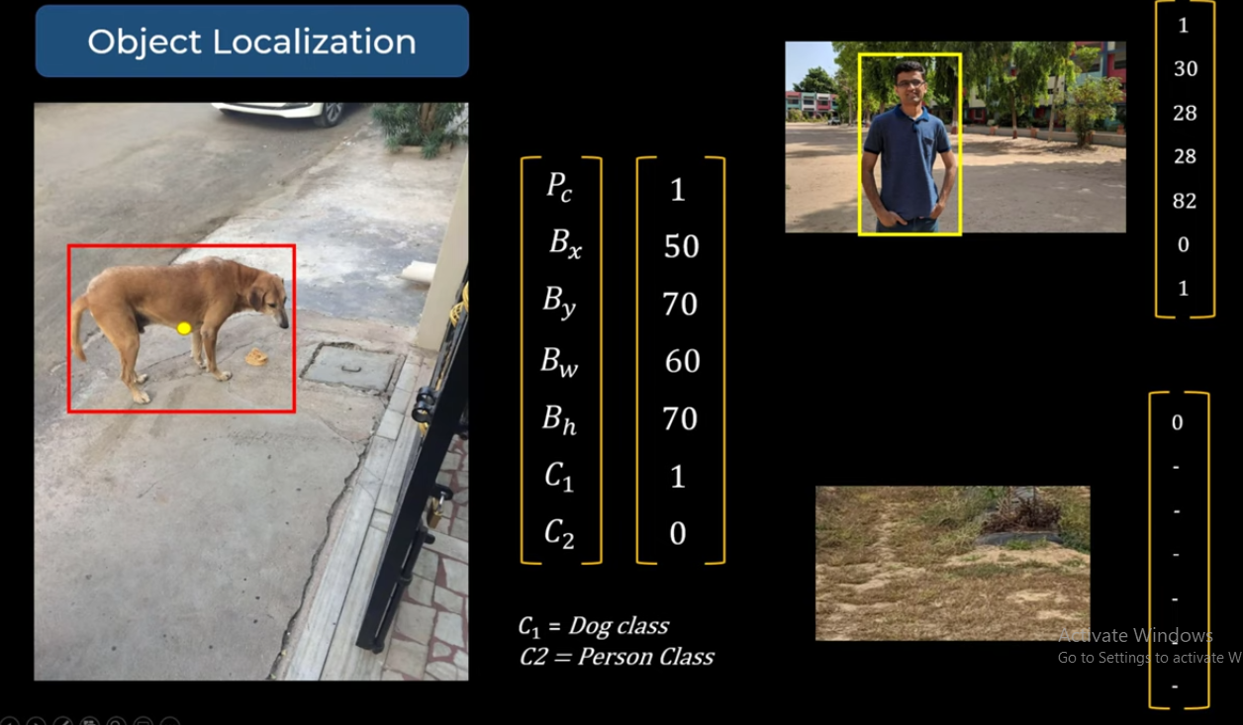

Slide 28
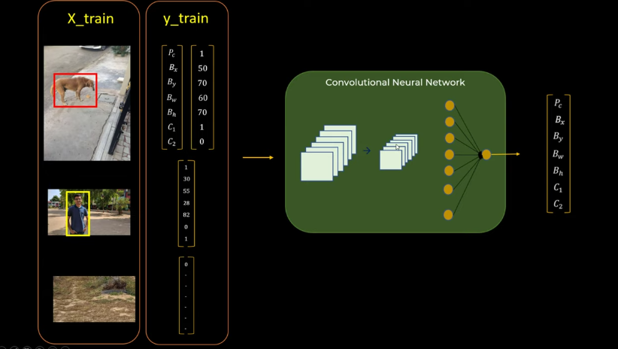

Slide 29
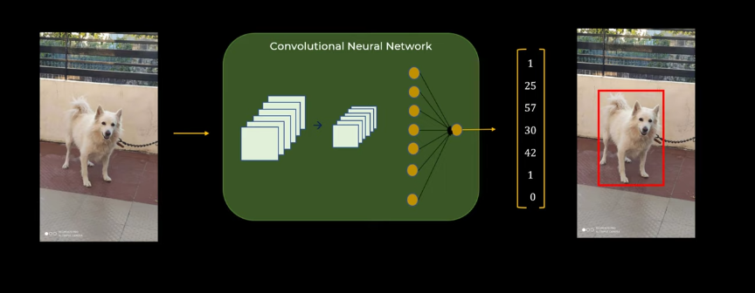

Slide 30
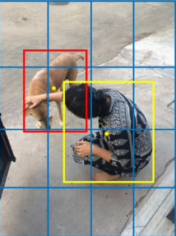
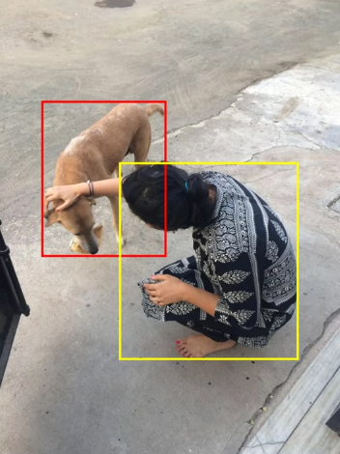

Slide 31
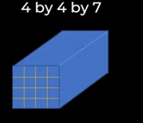
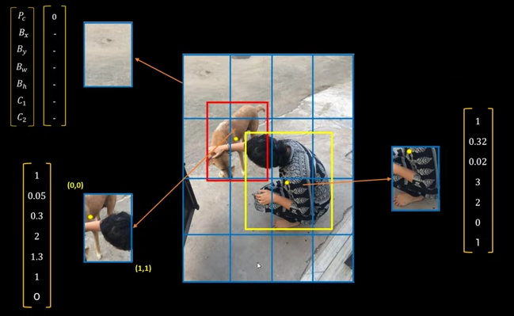

Slide 32
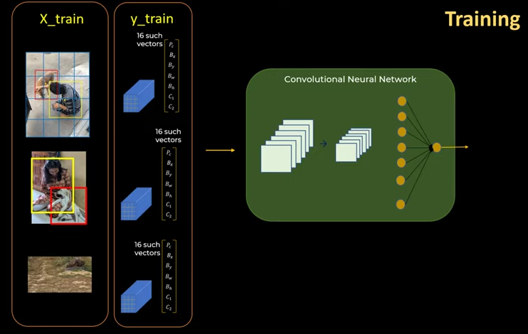

Slide 33
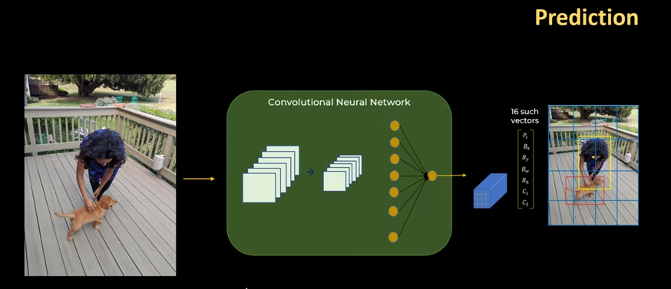

Slide 34
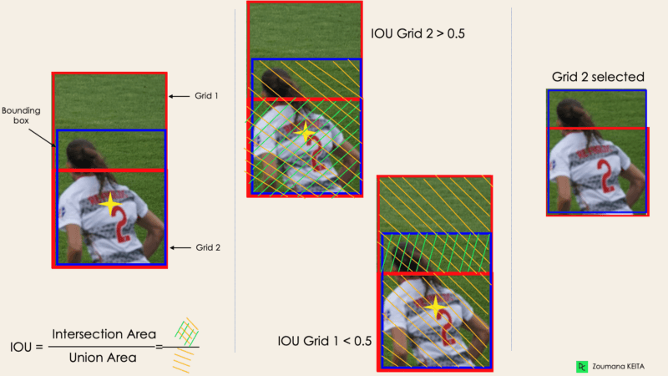
Intersection Over Union (IOU)

Slide 35
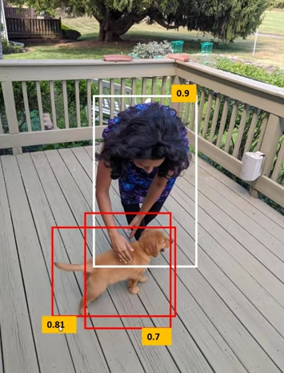
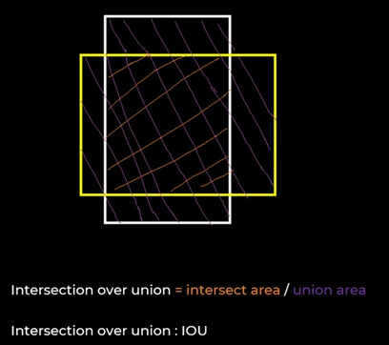
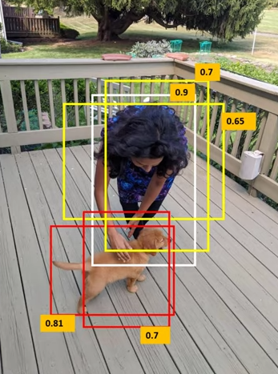
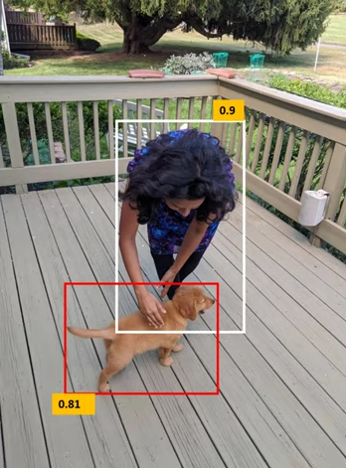

Slide 36
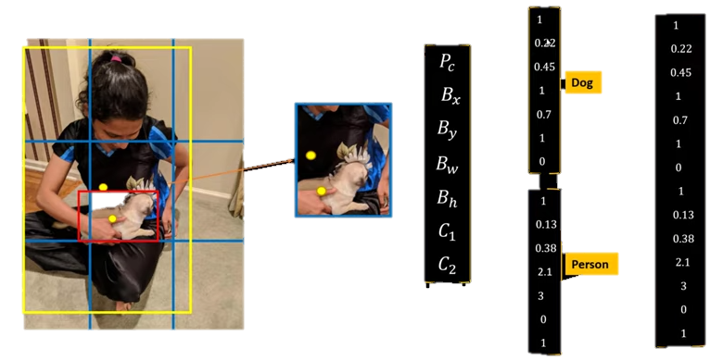

Slide 37
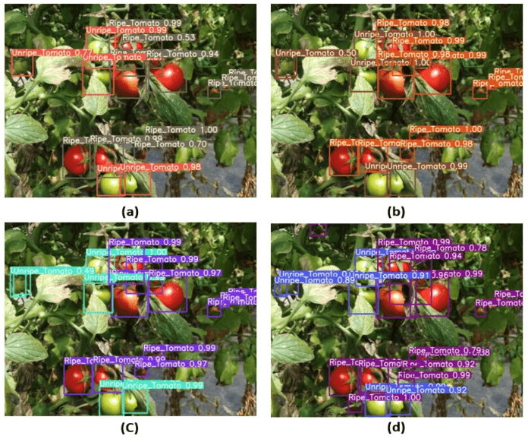
Applications
Agriculture:

Slide 38
Resources
https://www.v7labs.com/blog/yolo-object-detection
https://www.datacamp.com/blog/yolo-object-detection-explained
https://www.section.io/engineering-education/introduction-to-yolo-algorithm-for-object-detection/
https://www.youtube.com/watch?v=ag3DLKsl2vk

